Slide 1
Lead Scoring Case Study (Insights Presentation)
- worked complied by
Hrishikesh Pradhan
Hitesh Padal
Imtihazahmad Mullanavar

Slide 2
Contents
Problem Statement
Business Brief
Business Problem
Data Brief
Goal Brief
Exploratory Data Analysis (EDA) Procedure
EDA - Data Handling
EDA - Insights

Slide 3

Problem Statement – Business Brief
An education company named X Education sells online courses to industry professionals. On any given day, many professionals who are interested in the courses land on their website and browse for courses.
The company markets its courses on several websites and search engines like Google. Once these people land on the website, they might browse the courses or fill up a form for the course or watch some videos.
When these people fill up a form providing their email address or phone number, they are classified to be a lead.
Moreover, the company also gets leads through past referrals. Once these leads are acquired, employees from the sales team start making calls, writing emails, etc.
Through this process, some of the leads get converted while most do not. The typical lead conversion rate at X education is around 30%.

Slide 4
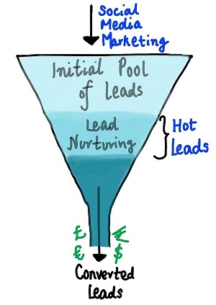
Problem Statement – Business Problem
Now, although X Education gets a lot of leads, its lead conversion rate is very poor. For example, if, say, they acquire 100 leads in a day, only about 30 of them are converted.
To make this process more efficient, the company wishes to identify the most potential leads, also known as ‘Hot Leads’.
If they successfully identify this set of leads, the lead conversion rate should go up as the sales team will now be focusing more on communicating with the potential leads rather than making calls to everyone.
A typical lead conversion process can be represented using the funnel (image).
Based on the funnel, there are a lot of leads generated in the initial stage (top) but only a few of them come out as paying customers from the bottom.
In the middle stage, it is required to nurture the potential leads well (i.e. educating the leads about the product, constantly communicating etc. ) in order to get a higher lead conversion.
Lead Conversion Process
- Demonstrated as a funnel

Slide 5
Problem Statement – Data Brief
We have been provided with a leads dataset from the past with around 9000 data points.
This dataset consists of various attributes such as Lead Source, Total Time Spent on Website, Total Visits, Last Activity, etc. which may or may not be useful in ultimately deciding whether a lead will be converted or not.
The target variable, in this case, is the column ‘Converted’ which tells whether a past lead was converted or not wherein 1 means it was converted and 0 means it wasn’t converted.
More about the dataset available from the data dictionary provided in the zip folder at the end of the page.
Another thing that is required to check out are the levels present in the categorical variables. Many of the categorical variables have a level called 'Select' which needs to be handled because it is as good as a null value (because that means the value has not been selected and a default value was taken as 'Select').

Slide 6
Problem Statement – Goal Brief
Business Goal:
To help X Education select the most promising leads, i.e. the leads that are most likely to convert into paying customers.
The company requires us to build a model wherein we need to assign a lead score to each of the leads such that the customers with a higher lead score have a higher conversion chance and the customers with a lower lead score have a lower conversion chance.
The CEO, in particular, has given a ballpark of the target lead conversion rate to be around 80%.
Technical Procedure:
Build a logistic regression model to assign a lead score between 0 and 100 to each of the leads which can be used by the company to target potential leads. A higher score would mean that the lead is hot, i.e. is most likely to convert whereas a lower score would mean that the lead is cold and will mostly not get converted.
There are some more problems presented by the company for which, model should be able to adjust to if the company's requirement changes in the future, therefore will need to handle these as well. These problems are provided in a separate doc file and will be answered based on the logistic regression model built in the first step.

Slide 7
Exploratory Data Analysis (EDA) Procedure
To identify
Volume of data
Attributes/Columns in the dataset
& Cleaning the attribute data
Imputing missing values wherever applicable (Categorical: Mode; Numeric: Median)
Ignoring imputation if the proportion of missing values is very high (ex: more than 20% missing data)
Text based attributes: Updating the values to proper case / correcting spellings as applicable to give meaning to values and avoid duplicates in the unique values list.
To analyse the attributes
To understand the distribution of data in the attributes
To understand the distribution proportional of data in the attributes w.r.t. the ‘Converted’ attribute(s)
Identify the abnormal distribution among the attribute values, and stating the reasons if insightful
Identify the proportion of distribution w.r.t. ‘Target’ and flagging/stating such attribute values as segments of attention and further actions to be taken by business team as applicable to reduce/avoid unfavourable criteria

Slide 8
EDA – Data Handling (Leads.csv)
All the observations in this process (data handling) and actions taken are stated adjacent to the step/cell where such action is performed.
Some imputations may be based on assumption/data understanding, rather than empirical method(s).
Step by step actions taken:
Removed ‘Prospect ID’ and ‘Lead Number’
Replaced dummy ‘Select’ values with nan
Obtained count and proportion of null values in each column, large distribution of null values shown below ie., > 40%
Removed these attributes to avoid bias in predictions
Replaced missing values on the column
Replaced certain low frequent values on the column
How did you hear about X Education | 78.46 | Asymmetrique Activity Score | 45.65
Lead Profile | 74.19 | Asymmetrique Profile Score | 45.65
Lead Quality | 51.59 | Asymmetrique Profile Index | 45.65
 |  | Asymmetrique Activity Index | 45.65
‘City’ with Mode = ‘Mumbai’. | ‘What is your current occupation’ with ‘Unemployed’
‘Specialization’ with ‘Not Specified’ | ‘Lead Source’ with ‘Others’
‘Tags’ with ‘Not Specified | ‘Last Activity’ with ‘Others’
‘Tags’ with ‘Other_Tags’ | ‘Lead Source’ with ‘Others’ | ‘Last Activity’ with ‘Others’

Slide 9
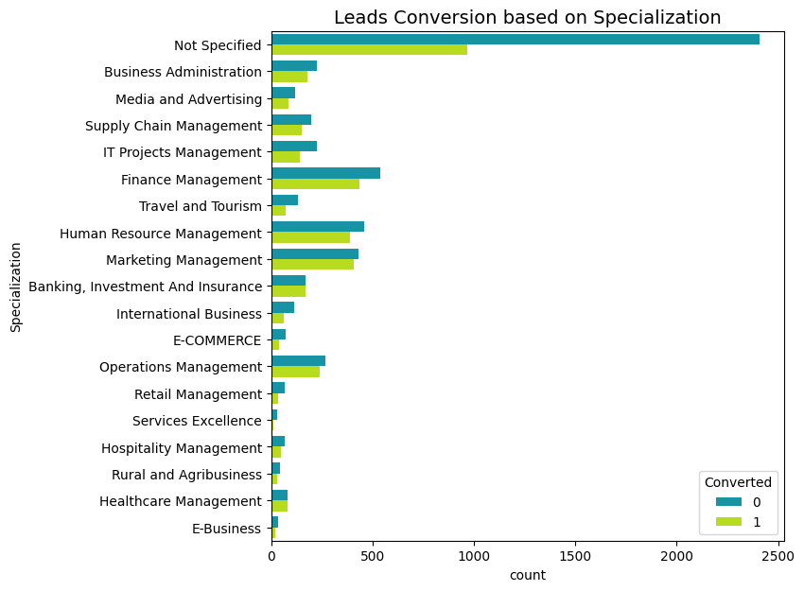
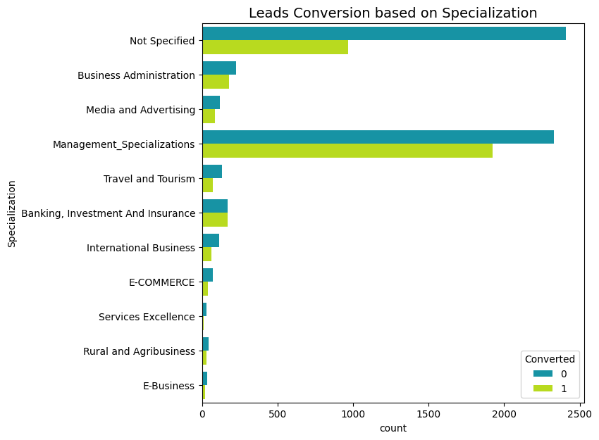
EDA – Data Insights
Based on Specialization, more number and significant proportion of leads are converted among these choices:: Management: Finance, Human Resource, Marketing, and Operations.
After grouping all Management Specializations as one, it has highest number of leads converted.

Slide 10
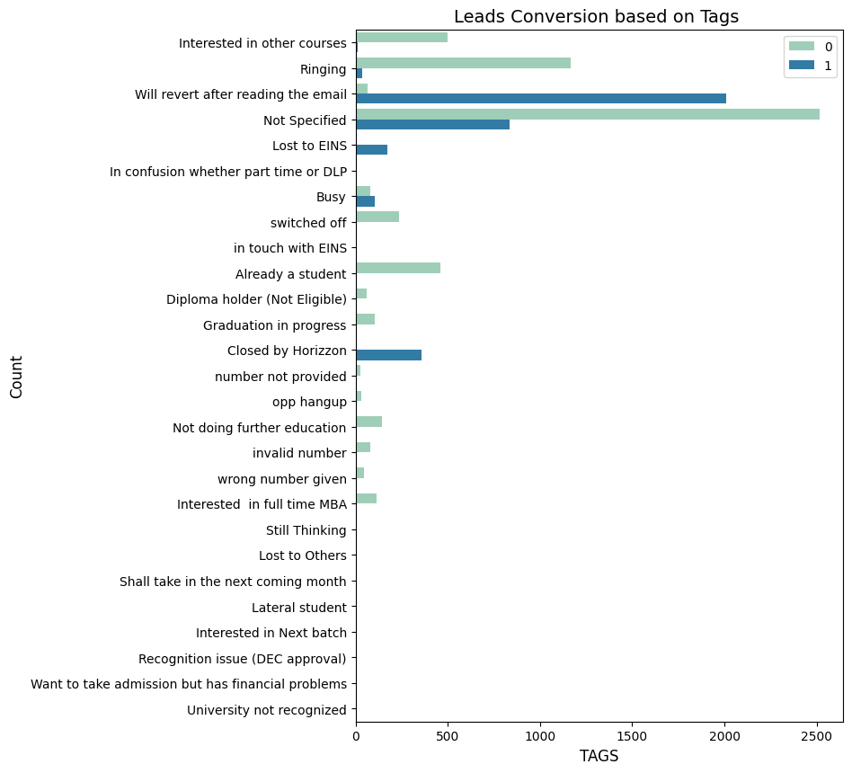
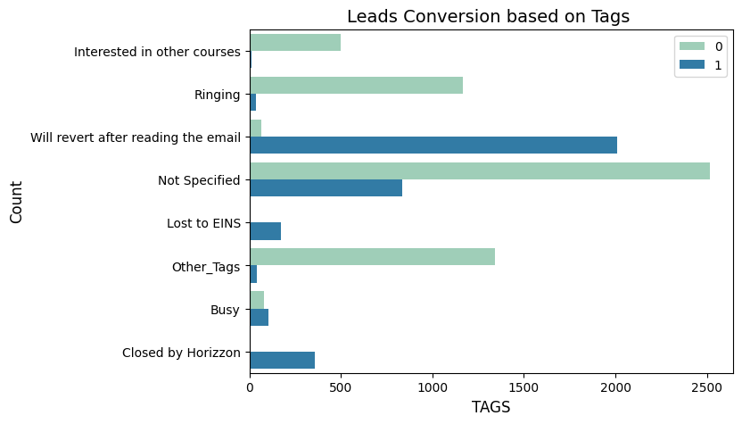
EDA – Data Insights (contd.)
Based on Tags, more number and significant proportion of leads are converted among these choices:: Will revert after reading the email.
After grouping the very less count categories as one: Other_Tags, we have negligible conversions from this group.

Slide 11
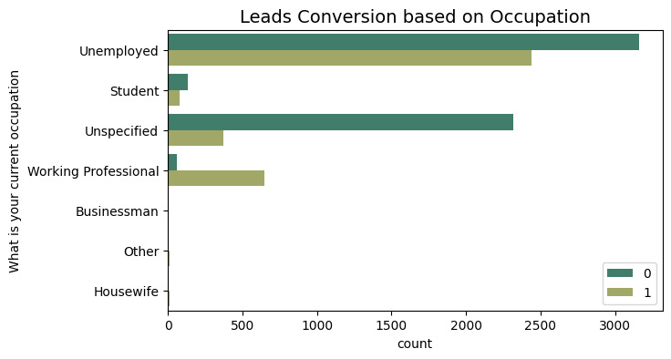
EDA – Data Insights (contd.)
Based on Occupation, more number and significant proportion of leads are converted among these choices:: Unemployed and Unspecified.
There is a strong likelihood that working professionals will opt for the course.
The largest group among the leads consists of unemployed individuals, and those who didnot specify any choice.
Categories like housewives, businessmen, students, and others are less likely to convert and enroll in the course.

Slide 12
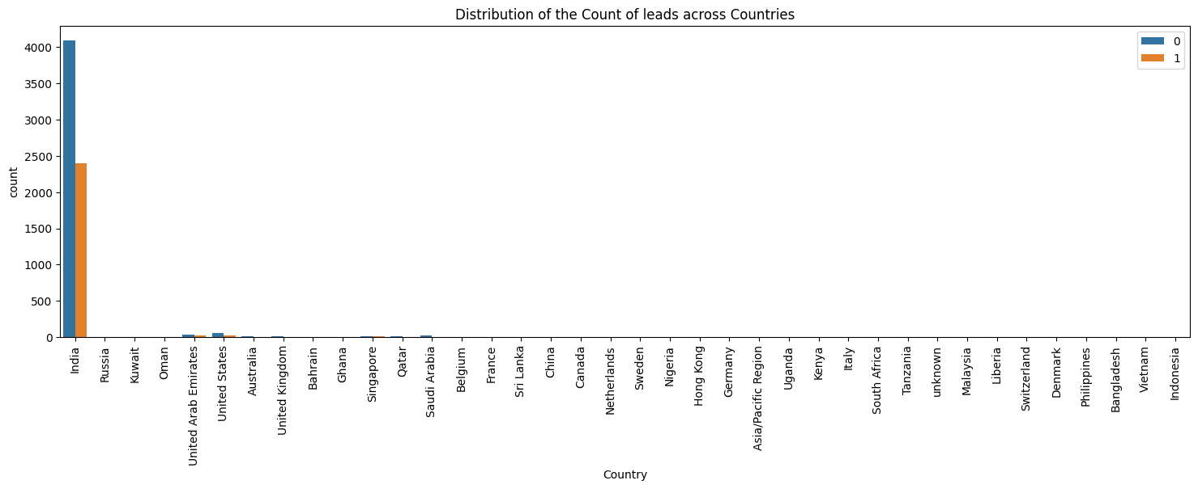
EDA – Data Insights (contd.)
Based on Country, more number and significant proportion of leads are converted among these choices:: India.
Because "India" shows as the most occurring Country, it may not be suitable for an analysis - especially for a classification problem. Therefore we remove the Country column to avoid the bias and high VIF.

Slide 13
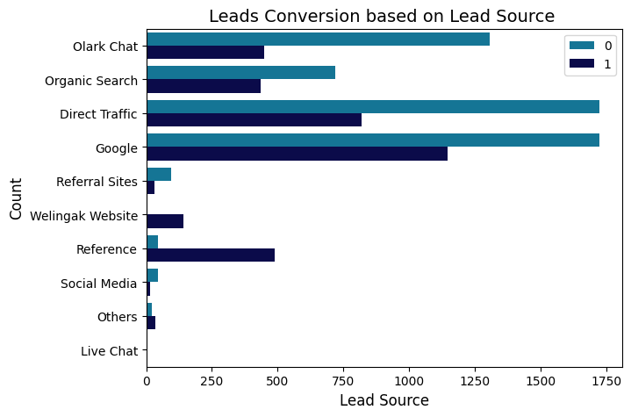
EDA – Data Insights (contd.)
Based on Lead Source,
The majority of leads are generated through Google and direct traffic, with the fewest coming from live chat.
The Welingak website has the highest conversion rate.
Improving lead conversion can be achieved by maximizing leads from references and the Welingak website.
Focusing on Olark chat, organic search, direct traffic, and Google leads could further boost lead conversion rates.

Slide 14
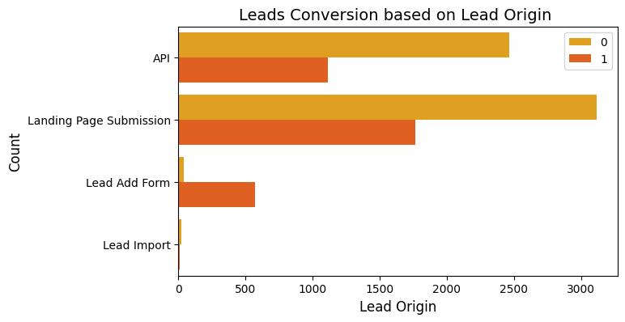
EDA – Data Insights (contd.)
Based on Lead Origin,
Both API and landing page submissions generate a high volume of leads and conversions.
While the lead add form has a strong conversion rate, the number of leads it generates is relatively low.
Increasing the number of leads through the lead add form could significantly boost the overall conversion rate and contribute to greater growth.

Slide 15
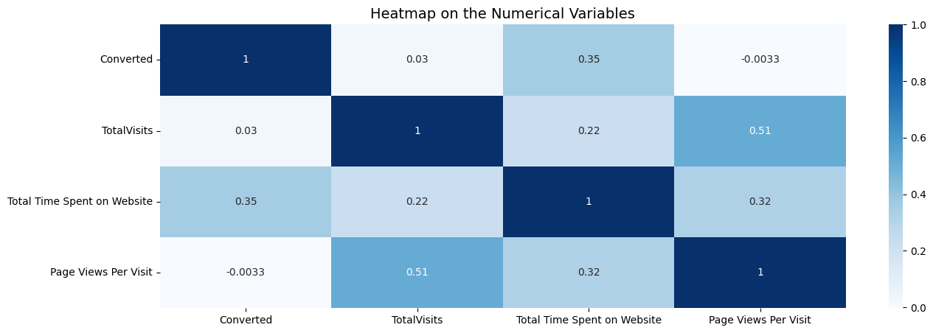
EDA – Data Insights (contd.)
Correlation analysis of numeric variables
Users who spent more time on website are more likely to get converted with 35% probability.
Total visits to the website is highly correlated with Total time spent on website, and page views per visit is highly correlated with total visits.

